Slide 1
Chapter 4
System Design

Slide 2
What is System Design ?
the process of creating a detailed plan or blueprint for the development and implementation of a system
It involves defining :-
Components
modules
interfaces
data flows
functionality of a system

Slide 3
Popular graphical modeling languages include
Unified Modeling Language (UML)
Flowcharts
Entity-Relationship Diagrams (ERD)
System Modeling Language (SysML)

Slide 4
System Design Goals
to create a system that effectively meets the needs and requirements of its stakeholders
while optimizing for various factors such as :
performance
reliability
maintainability
usability
cost

Slide 5
Some common goals of system design include
Functionality
Performance
Reliability
Maintainability
Usability
Scalability
Security
Cost-effectiveness
Interoperability
Compliance
Modularity
Flexibility
Robustness
Reusability
Testability
Traceability
Time-to-Market
Sustainability

Slide 6
Design Tradeoffs
Complexity vs. Simplicity
Flexibility vs. Specificity
Scalability vs. Resource Usage:
Security vs. Usability
Innovation vs. Stability

Slide 7
System Decomposition
essential step in system design
system partitioning or system breakdown
is the process of breaking down a complex system into smaller, more manageable subsystems or components
as it helps in understanding the system's structure, function, and behavior, and enables more effective system development, analysis, and management

Slide 8
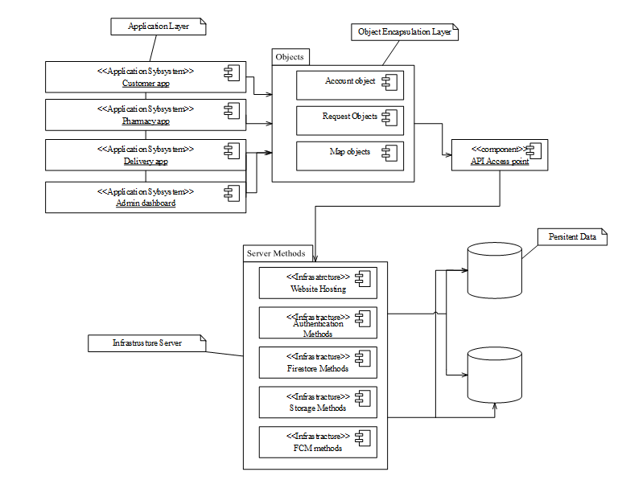
...Continued

Slide 9
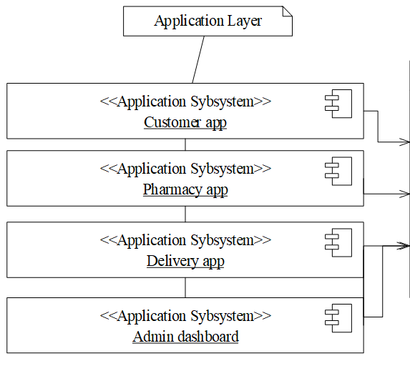
...Continued

Slide 10
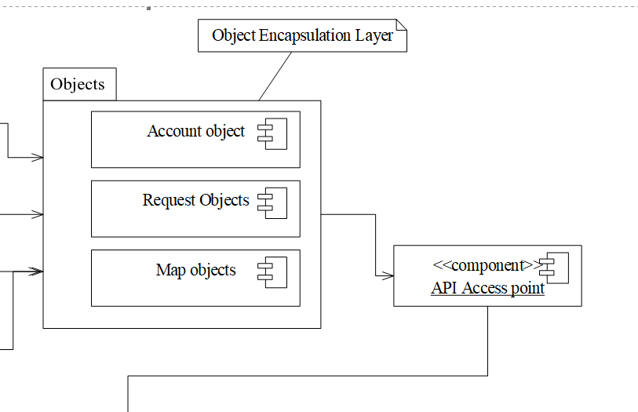
...Continued

Slide 11
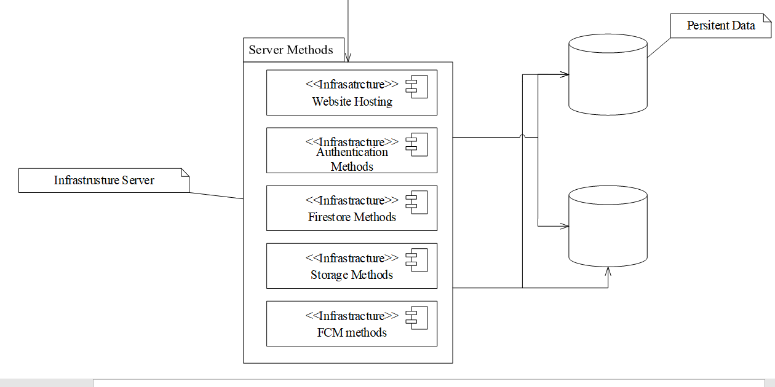
...Continued

Slide 12
Design Phase Models
systematic approaches used in system design to guide the development of high-quality, efficient, and effective solutions
Some of the design phase models include:
Class Diagram
Persistence model
User Interface design
Deployment diagram
Network diagram

Slide 13
Class Diagram
used during the design phase of software development
to model the static structure of a system's object-oriented components
to visualize the relationships and interactions among classes.
They help in understanding
the organization of classes
their attributes methods
their relationships

Slide 14
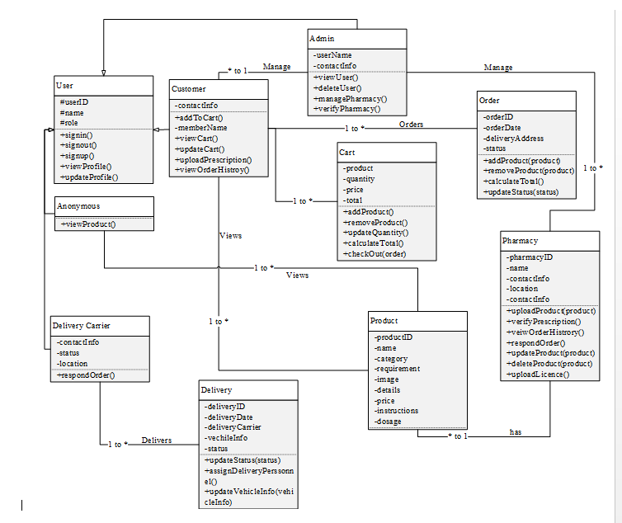
...Continued

Slide 15
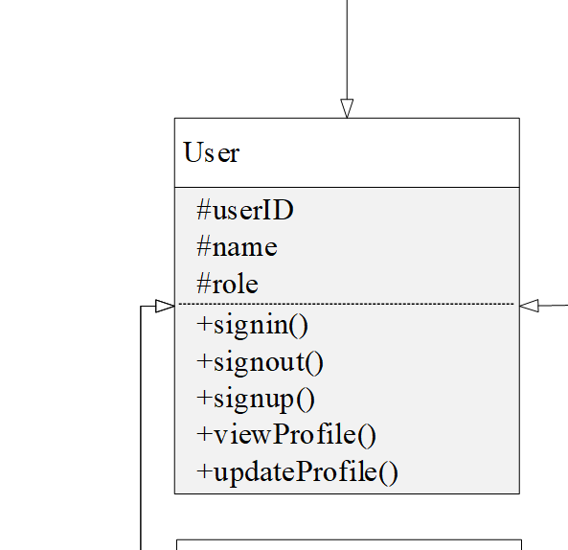
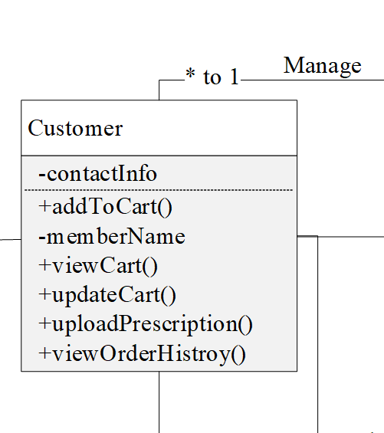
...Continued

Slide 16
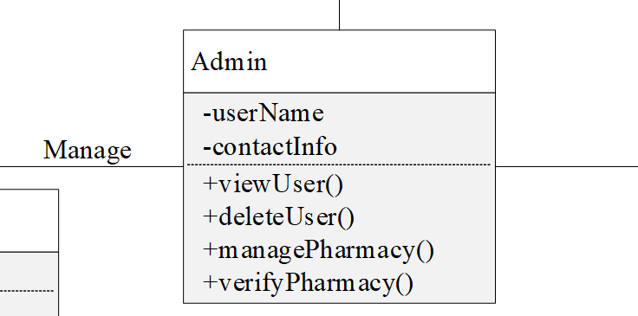
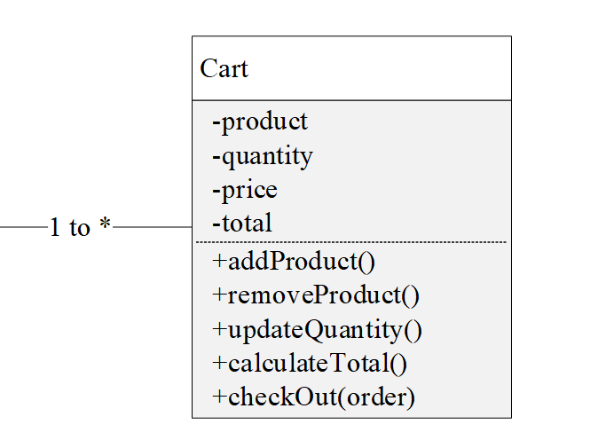
...Continued

Slide 17
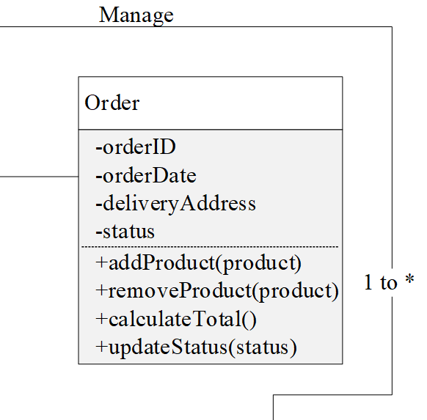
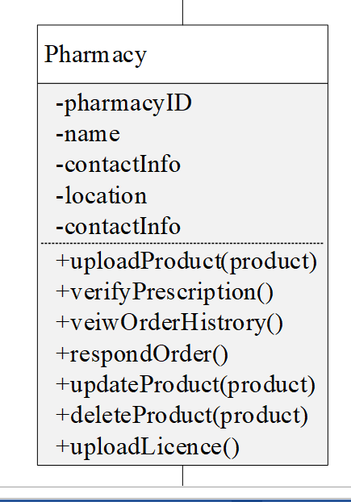
...Continued

Slide 18
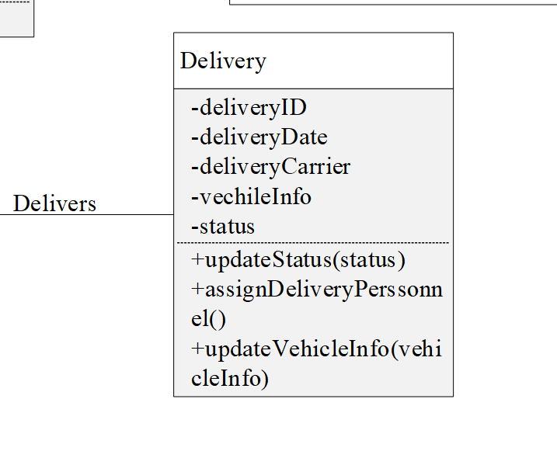
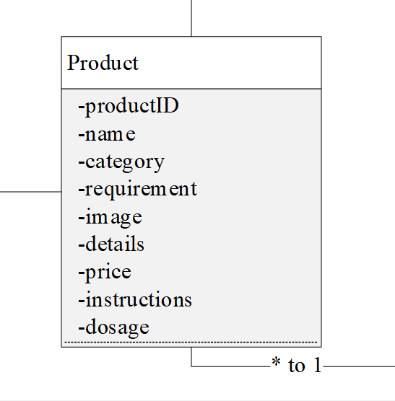
...Continued

Slide 19
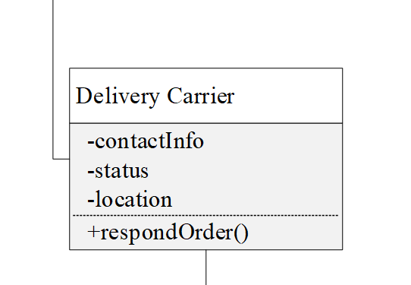
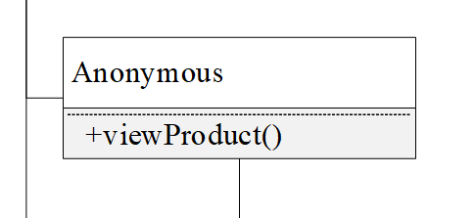
...Continued

Slide 20
Persistence model
persistence refers to the characteristic of state of a system that outlives the process that created it.
This is achieved in practice by storing the state as data in data storage
Firebase

Slide 21
...Continued
NoSQL databases are often chosen for projects based on their specific advantages and suitability for certain use cases.
Here are some reasons why :
Scalability
Flexibility
Performance
Cost-effectiveness
Distributed and fault-tolerant architecture
Developer productivity

Slide 22
User interface design
User Interface (UI) refers to the graphical and interactive elements that allow users to interact with a software application, website, or system
A well-designed UI should be intuitive, visually appealing, and efficient in helping users achieve their goals with the application

Slide 23

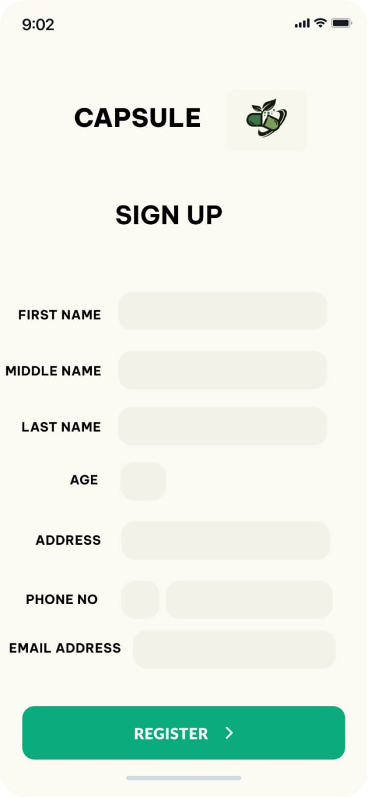
...Continued

Slide 24

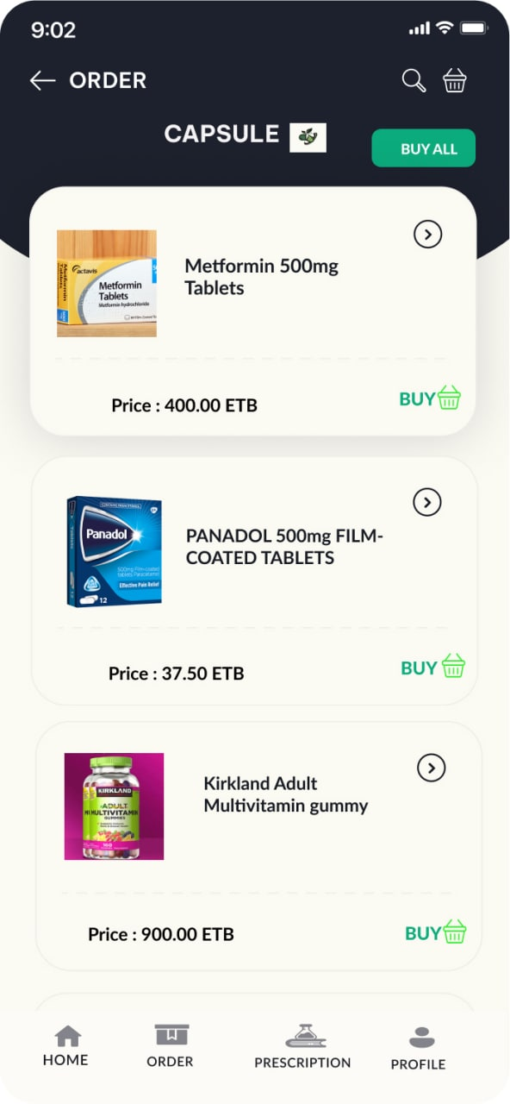
...Continued

Slide 25
Deployment Diagram
type of UML (Unified Modeling Language) diagram that represents the physical deployment of software components and their relationships on hardware nodes or servers.

Slide 26
...Continued

Slide 27
Network Diagram
A network diagram is a visual representation of the components and connections of a computer network.
It provides a graphical representation of how devices, such as computers, servers, switches, routers, and other networking devices, are connected and communicate with each other within a network

Slide 28
...Continued

Slide 29
Thank you

